Slide 1

WEB TECHNOLOGIES
HTML - Basic Markups
Vinay Joshi
Department of
Computer Science and Engineering

Slide 2

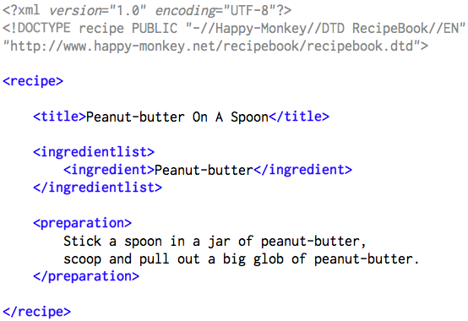
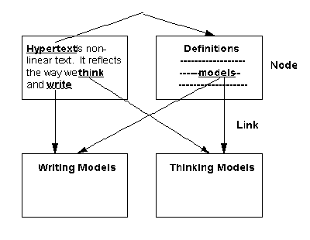
HTML – Basic Markups
Introduction
HTML – Hyper Text Markup Language
Hypertext - cross-referencing /linking between related sections of text and associated graphic material
Markup - define elements within a document using tags

Slide 3
HTML – Basic Markups
Basic Syntax
Elements are defined by tags (markers)
Tag format:
Opening tag: <tag_name>
Closing tag: </tag_name>
Syntax:
<tag_name>
Content…
</tag_name>
Not all tags have content
If a tag has no content, its form is <tag_name … />
The container and its content together are called an element

Slide 4
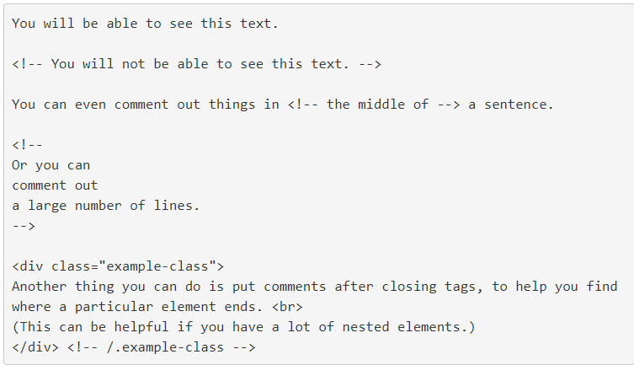
HTML – Basic Markups
Comments
An HTML comment begins with <! – – and the comment closes with – –>.
HTML comments are visible to anyone that views the page source code, but are not rendered when the HTML document is rendered by a browser.

Slide 5
HTML – Basic Markups
Document Structure
<html>
<head>
<title>… </title>
</head>
<body>
…
</body>
</html>

Slide 6
HTML – Basic Markups
Document Structure
Every XHTML document must begin with <html>
<html>, <head>, <title>, and <body> are required in every document
The whole document must have <html> as its root
A document consists of a head and a body
The <title> tag is used to give the document a title, which is normally displayed in the browser’s window title bar (at the top of the display)

Slide 7
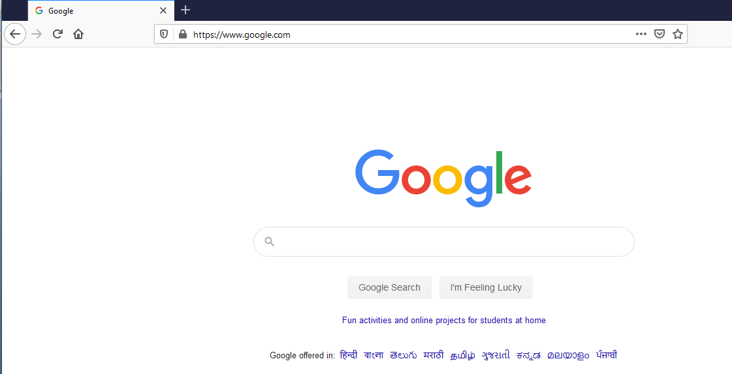
HTML – Basic Markups
Document Structure
title
body

Slide 8

HTML – Basic Markups
Common Tags / Elements
Images
Paragraph
Headings
Links

Slide 9
HTML – Basic Markups
Common Tags / Elements
Text Content
Paragraphs
Headings
Lists
Tables
Images
Links

Slide 10
HTML – Basic Markups
Paragraph
Text is normally placed in paragraph elements
Paragraph Elements:
The <p> tag breaks the current line and inserts a blank line - the new line gets the beginning of the content of the paragraph
The browser puts as many words of the paragraph’s content as will fit in each line
Example:
<p>
A paragraph always starts on a new line, and browsers automatically add some white space (a margin) before and after a paragraph.
</p>

Slide 11
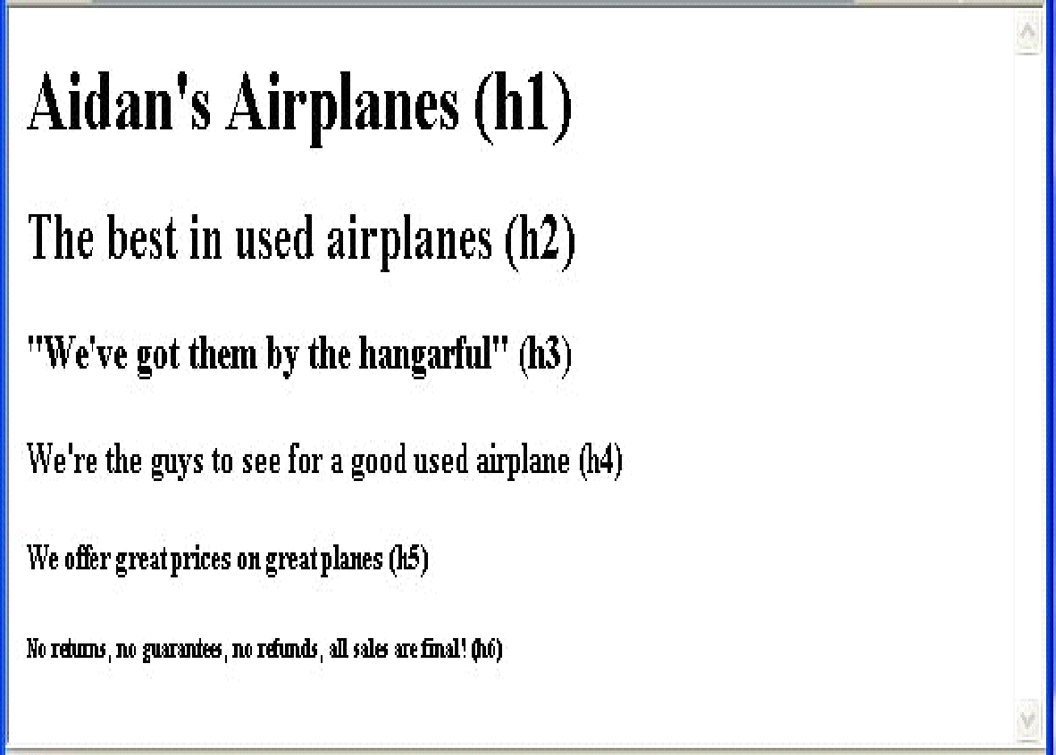
HTML – Basic Markups
Headings
Example:
<body>
<h1> Aidan’s Airplanes </h1>
<h2> The best in used airplanes </h2>
<h3> "We’ve got them by the hangarful" </h3>
<h4> We’re the guys to see for a good used airplane /h4> <!– Regular text size -->
<h5> We offer great prices on great planes </h5>
<h6> No returns, no guarantees, no refunds </h6>
</body>

Slide 12
HTML – Basic Markups
Formatting tags
Superscripts and subscripts
Subscripts with <sub>
Superscripts with <sup>
Example: x<sub>2</sub><sup>3</sup>
Display: x₂³
Inline versus block elements
Block elements CANNOT be nested in inline elements

Slide 13
HTML – Basic Markups
Special Characters
Character Entities:
Char. Entity Meaning
& &amp; Ampersand
< &lt; Less than
> &gt; Greater than
” &quot; Double quote
’ &apos; Single quote
(space) &nbsp; Non-breaking space
Horizontal rules:
<hr /> draws a line across the display, after a line break

Slide 14
HTML – Basic Markups
Images
GIF (Graphic Interchange Format) =8-bit color (256 different colors)
JPEG (Joint Photographic Experts Group) =24-bit color (16 million different colors)
Portable Network Graphics (PNG)
Images are inserted into a document with the <img /> tag with the src attribute
The alt attribute is required by XHTML
<img src = "comets.jpg" alt = "Picture of comets" />
The <img> tag has 30 different attributes, including width and height (in pixels)

Slide 15
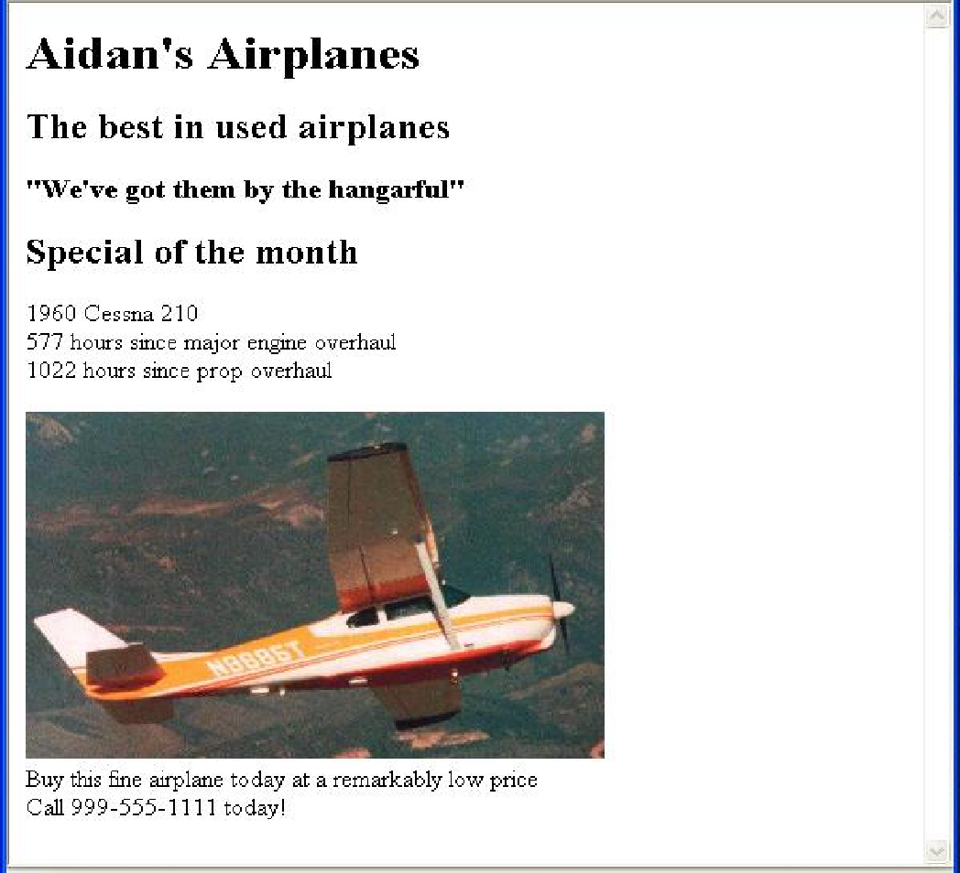
HTML – Basic Markups
Images…(cntd.)
<html>
<head> <title> Images </title>
</head>
<body>
<p>
<img src = "c210new.jpg" alt = "Picture of a Cessna 210"/>
<br />
Buy this fine airplane today at a
remarkably low price <br />
Call 999-555-1111 today!
</p>
</body>
</html>

Slide 16
HTML – Basic Markups
Hypertext Links
Hypertext is the essence of the Web!
A link is specified with the href attribute of <a> (the anchor tag)
The content of <a> is the visual link in the document
If the target is a whole document (not the one in which the link appears), the target need not be specified in the target document as being the target
Note: Relative addressing of targets is easier to maintain and more portable than absolute addressing

Slide 17
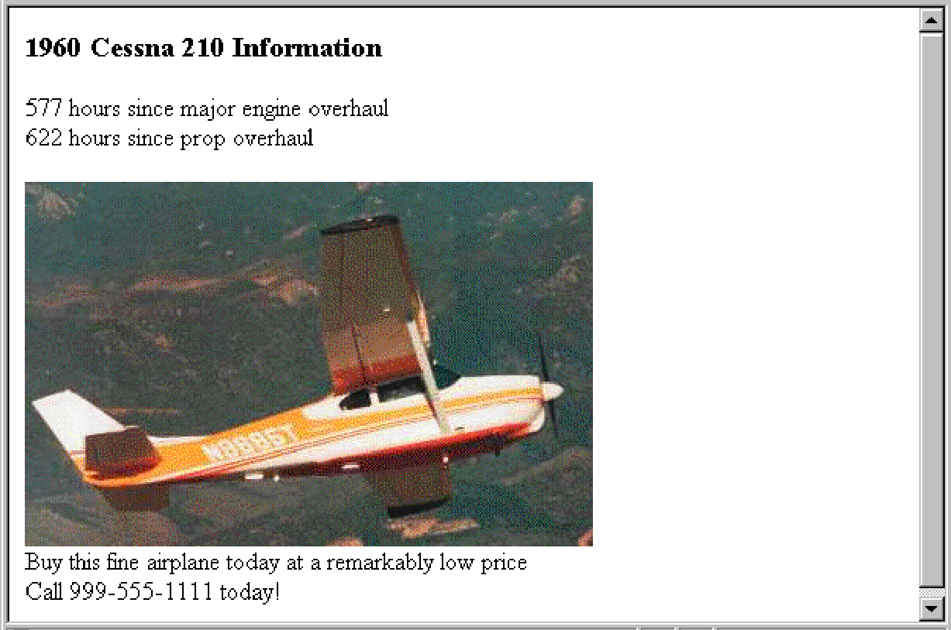
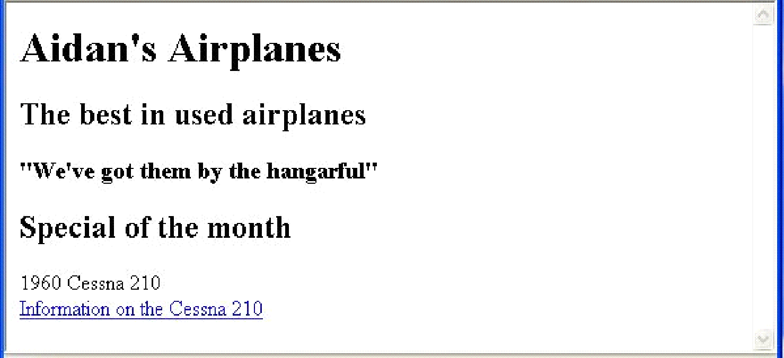
HTML – Basic Markups
Hypertext links…(cntd.)
Example:
<html>
<head> <title> Links </title> </head>
<body>
…
<h2> Special of the month </h2>
<p> 1960 Cessna 210 <br />
<a href = "C210data.html"> Information on the Cessna 210 </a>
</p>
</body>
</html>

Slide 18
HTML – Basic Markups
Lists
Used to present list of information in well formed and semantic way.
Three types of Lists:
Unordered list
Ordered list
Definition List

Slide 19
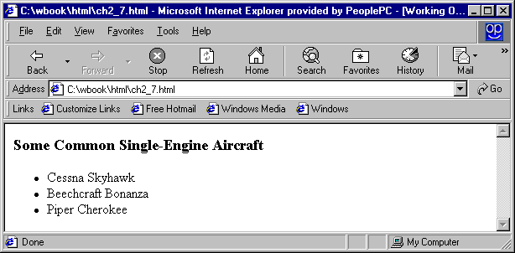
HTML – Basic Markups
Unordered Lists
The list is the content of the <ul> tag
List elements are the content of the <li> tag
<h3> Some Common Single-Engine Aircraft </h3>
<ul>
<li> Cessna Skyhawk </li>
<li> Beechcraft Bonanza </li>
<li> Piper Cherokee </li>
</ul>

Slide 20
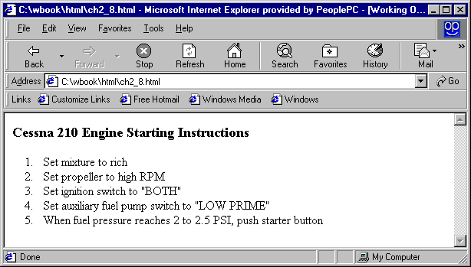
HTML – Basic Markups
Ordered Lists
The list is the content of the <ol> tag
Each item in the display is preceded by a sequence value
<h3> Cessna 210 Engine Starting Instructions</h3>
<ol>
<li> Set mixture to rich </li>
<li> Set propeller to high RPM </li>
<li> Set ignition switch to "BOTH" </li>
<li> Set auxiliary fuel pump switch to
"LOW PRIME" </li>
<li> When fuel pressure reaches 2 to 2.5
PSI, push starter button </li>
</ol>

Slide 21
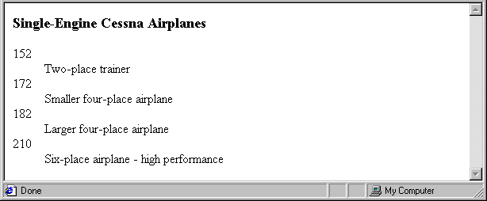
HTML – Basic Markups
Definition Lists
List is the content of the <dl> tag
Terms being defined are the content of the <dt> tag
The definitions themselves are the content of the <dd> tag
<h3> Single-Engine Cessna Airplanes </h3>
<dl >
<dt> 152 </dt>
<dd> Two-place trainer </dd>
<dt> 172 </dt>
<dd> Smaller four-place airplane </dd>
</dl>

Slide 22
HTML – Basic Markups
Tables
A matrix of cells, each possibly having content
The cells can include almost any element
Some cells have row or column labels and some have data
A table is specified as the content of a <table> tag
A border attribute in the <table> tag specifies a border between the cells
Tables are given titles with the <caption> tag, which can immediately follow <table>

Slide 23
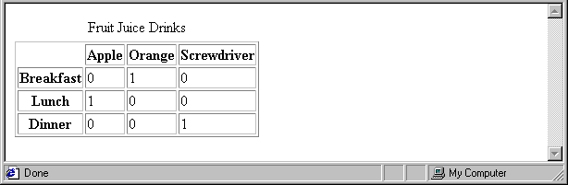
HTML – Basic Markups
Tables…(cntd.)
Each row of a table is specified as the content of a <tr> tag
The row headings are specified as the content of a <th> tag
The contents of a data cell is specified as the content of a <td> tag.
<table border = "border">
<caption> Fruit Juice Drinks </caption>
<tr>
<th> </th>
<th> Apple </th>
<th> Orange </th>
<th> Screwdriver </th>
</tr>
<tr>
<th> Breakfast </th>
<td> 0 </td>
<td> 1 </td>
<td> 0 </td>
</tr>
</table>

Slide 24
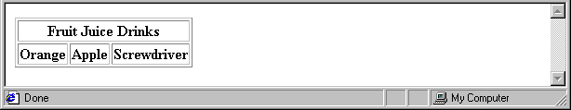
HTML – Basic Markups
Tables : Column Span
<tr>
<th colspan = "3"> Fruit Juice Drinks </th>
</tr>
<tr>
<th> Orange </th>
<th> Apple </th>
<th> Screwdriver </th>
</tr>

Slide 25
HTML – Basic Markups
Tables : Row Span
If the rows have labels and there is a spanning column label, the upper left corner must be made larger, using rowspan
<table border = "border">
<tr>
<td rowspan = "2"> </td>
<th colspan = "3"> Fruit Juice Drinks
</th>
</tr>
<tr>
<th> Apple </th>
<th> Orange </th>
</tr>
…
</table>

Slide 26
THANK YOU
Vinay Joshi
Department of Computer Science and Engineering
vinayj@pes.edu
+91 80 2672 6622

